Slide 1





00.
Cluster Analysis in R
Lessons Learnt From a Real-life Problem
CUSTOMER CLUSTERING OF GREATLENDER COPMANY
2021/10/07 RLadies Brisbane and RLadies Urmia Co-Event
https://www.meetup.com/rladies-Urmia/

Slide 2




01.
Mentorship Program 2021
Group Mentorship
One-on-one Mentorship
Stuart Flint
Maryam Alizadeh
Senior Data Scientist
Data Analyst
RLADIES URMIA

Slide 3
01.
Mentorship Program 2021
Group Mentorship
Benefits:
One-on-one Mentorship
Collaborate in solving problems
Providing feedback
Help in making goals
Help in making progress
Access to a broader network
RLADIES URMIA MENTORSHIP PROGRAM
RLADIES URMIA

Slide 4
What We Did For GreatLender(alias)
02.
GOAL OF THE PROJECT
We have applied Clustering analysis to the borrowers, provided for the development of the credit risk model.
We deal with a set of customers (women workers) characterized by their demographic information and financial situation.
Work was conducted to find the best combination of characteristics and the optimal number of clusters.
.
RLADIES URMIA

Slide 5

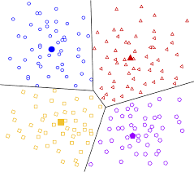
03.
Clustering Algorithms
BUSINESS VALUE OF CLUSTERING
Unsupervised learning algorithm is subjected to “unknown” data for which no previously defined categories or labels exist.
The machine learning system must teach itself to classify the data.
RLADIES URMIA
Explorium Blog: “Deploy it not as a standalone, but as part of a broader data discovery strategy.”
https://www.explorium.ai/blog/

Slide 6
GreatLender Data
04.
Loan Service to Women Workers
About 20 features of Demographic information, financial situation, and also some information about their employers

Slide 7
GreatLender Data
04.
Loan Service to Women Workers
About 20 features of Demographic information, financial situation, and also some information about their employers

Slide 8

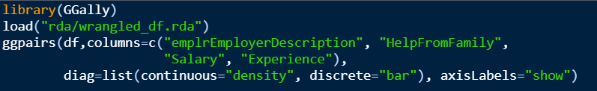
Pairs Plot of Data
05.
GGally Package
ggpairs()
Pairwise relations between mixed type variables
RLADIES URMIA

Slide 9
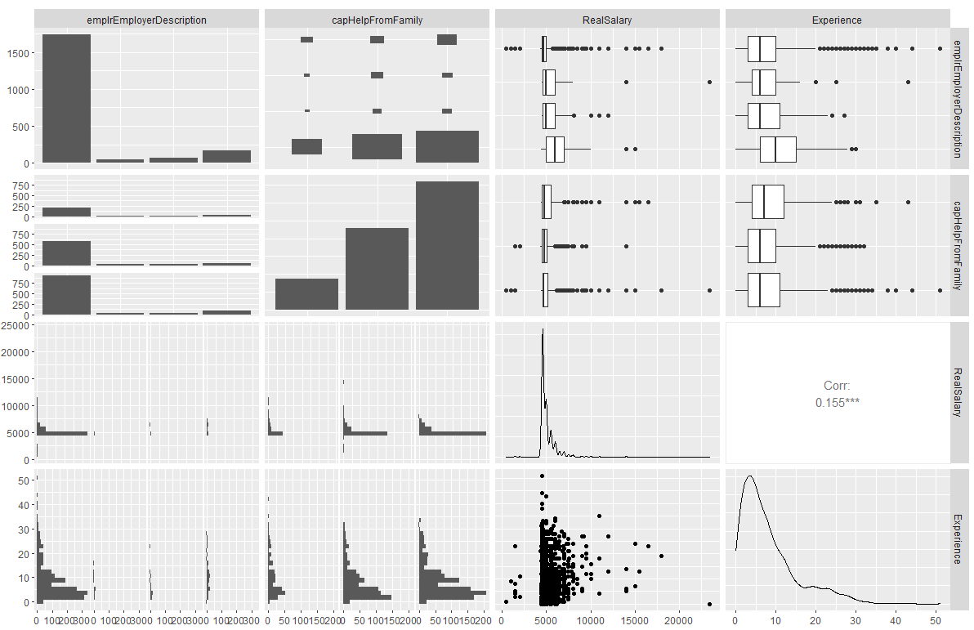
Pairs Plot of Data
Pairwise relations between mixed type variables
RLADIES URMIA

Slide 10
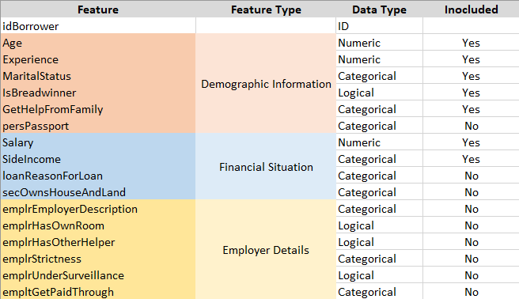

Feature Selection criteria Checklist
06.
Categorical variables with too many levels are removed;
Variables with more than 90% NA’s are removed;
Variables which are a duplicate of another variable;
Variables that are not user-specific;
Variables that have only one possible(or 90% dominant) value, excluding NA, are removed;
Clustering with optimized weights for Gower’s metric, By Jeroen van den Hoven

Slide 11
Feature Selection criteria Checklist
06.
Categorical data type to logical
Convert some categorical variables with too many levels to logical by combining the different levels based on domain or business experience
Numeric data type to categorical

Slide 12
07.
Convert Continuous into Categorical by Creating Bins
A very common task in data processing is the transformation of the numeric variables (continuous, discrete etc.) to categorical by creating bins. For example, is quite often to convert the age to the age groups.
Bin 1: [18:30]
Bin 2 : (30:45]
Bin 3: (45:60]
RLADIES URMIA

Slide 13
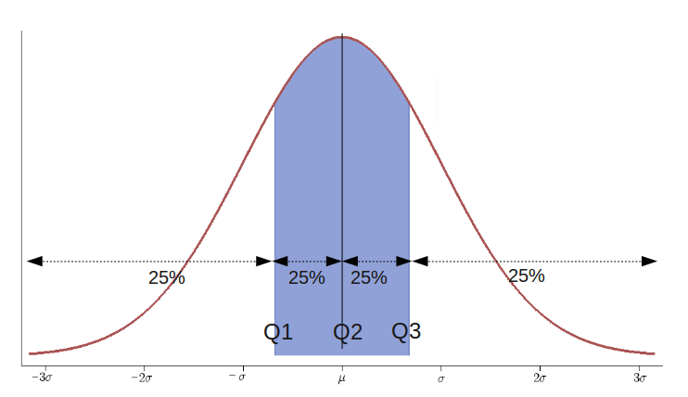
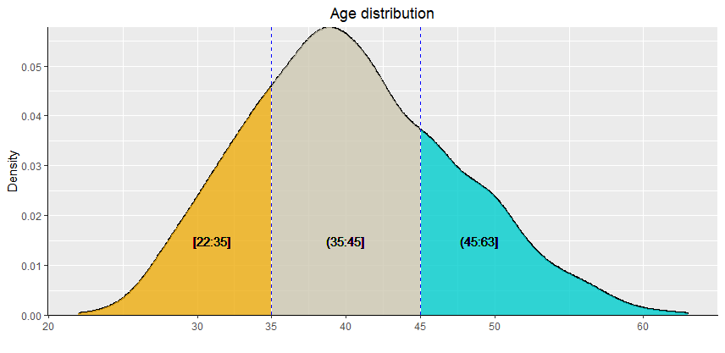
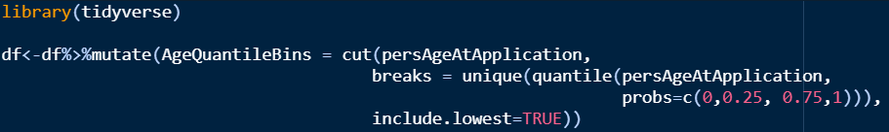
07.
Create Bins Based on Quantiles
Each bin based on age distribution. For example, 4 bins of an equal number of observations, i.e. 25% each. We can easily do it as using quantile() and cut() functions.
25%
50%
25%
RLADIES URMIA

Slide 14
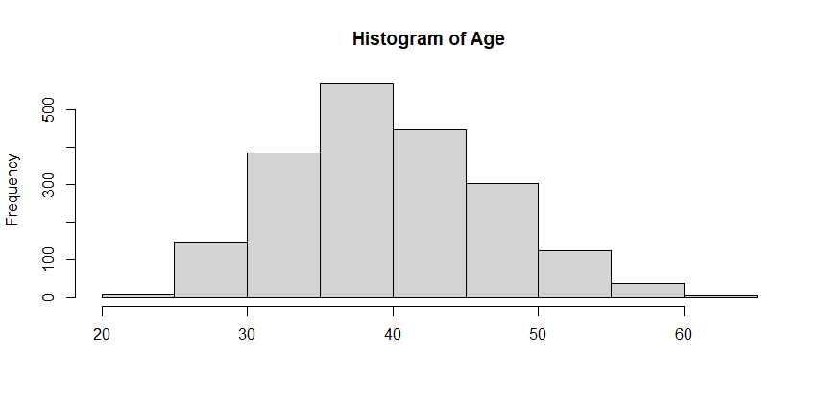
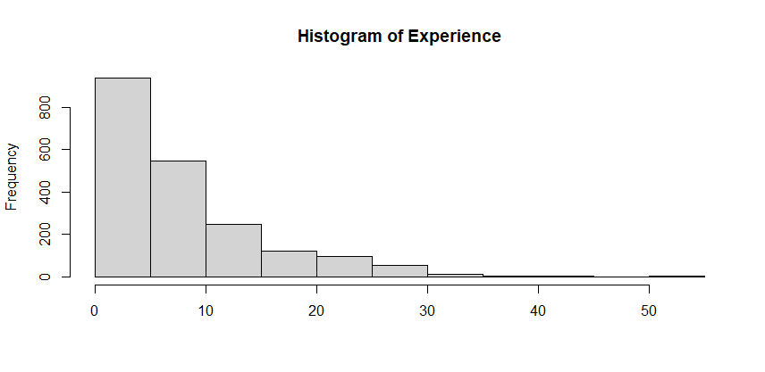
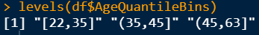
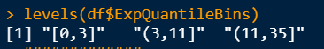
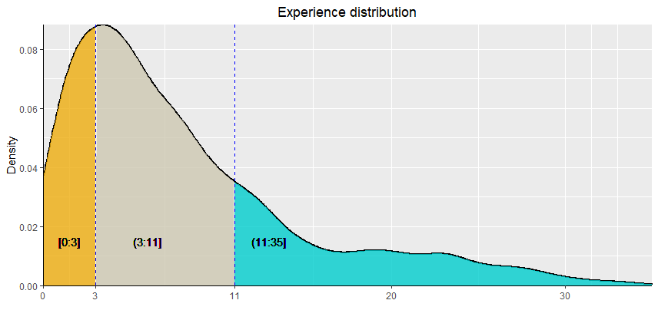
AGE GROUPS BASED ON QUANTILES
EXPERIENCE GROUPS BASED ON QUANTILES
25%
50%
25%

Slide 15
Choosing the Right Clustering Algorithm!
08.
Cluster Package
kmeans()
hclust()
8 FEATURES OF CATEGORICAL TYPE
RLADIES URMIA

Slide 16
09.
Hierarchical Agglomerative Clustering
RLADIES URMIA

Slide 17
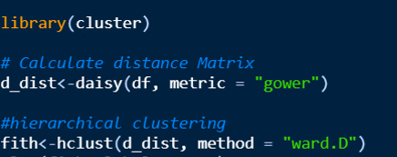
Calculating Distance by daisy and gower Metric
10.
Cluster Package
daisy()
RLADIES URMIA

Slide 18
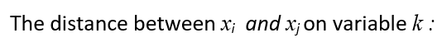
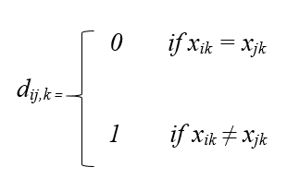
Calculating Distance by daisy and gower Metric
10.
Dissimilarity Matrix Calculation
Gower is a scaling algorithm applied to mixed numeric and categorical data to bring all variables to a 0–1 range.
The distance between x_{i} and x_{j} values on categorical variable k, is 0 when their value is equal. and otherwise 1.

Slide 19
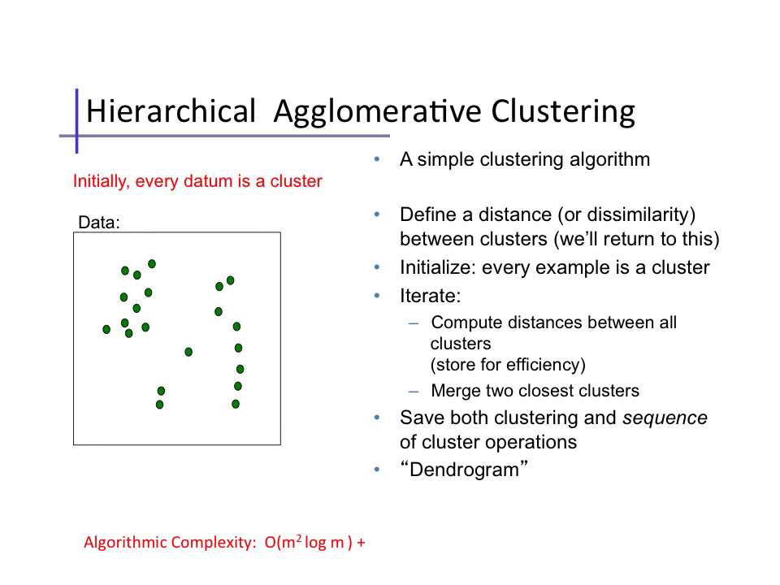
11.
Initially, every datum is a Cluster
M points
M clusters
Hierarchical Agglomerative Clustering
A simple clustering algorithm
Define a distance (or dissimilarity) between clusters
Initialize: every example is a cluster
Iterate:
Compute distances between all clusters
Merge two closest clusters
Save both clustering and sequence of cluster operations
Dendrogram
RLADIES URMIA

Slide 20
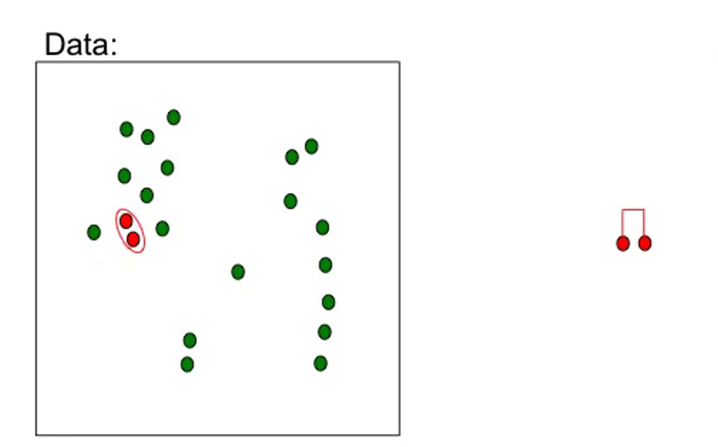
11.
Iteration 1, build up a sequence of clusters (Hierarchical)
Dendrogram
Height of the join indicates dissimilarity
RLADIES URMIA

Slide 21
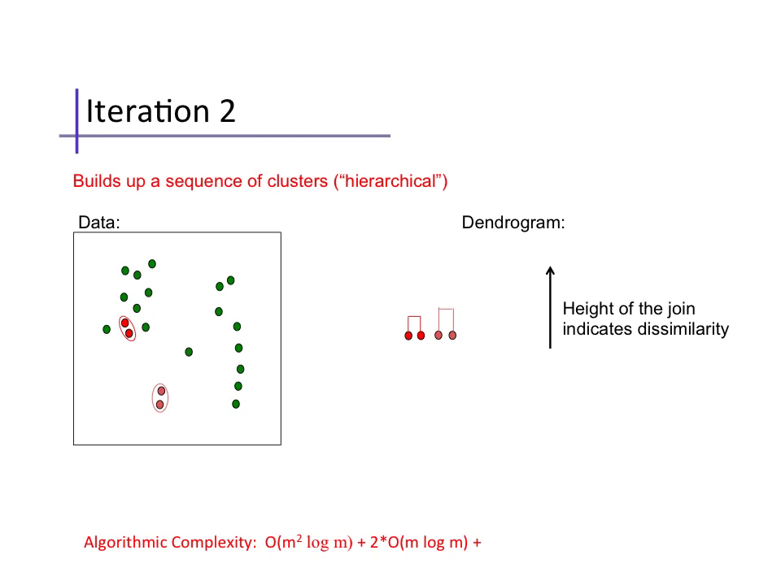
11.
Iteration 2, build up a sequence of clusters (Hierarchical)
Dendrogram
Height of the join indicates dissimilarity
RLADIES URMIA

Slide 22
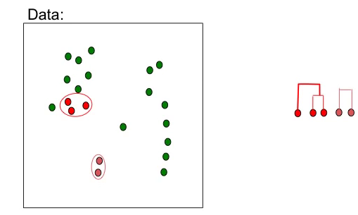
11.
Iteration 3, build up a sequence of clusters (Hierarchical)
Dendrogram
Height of the join indicates dissimilarity
RLADIES URMIA

Slide 23
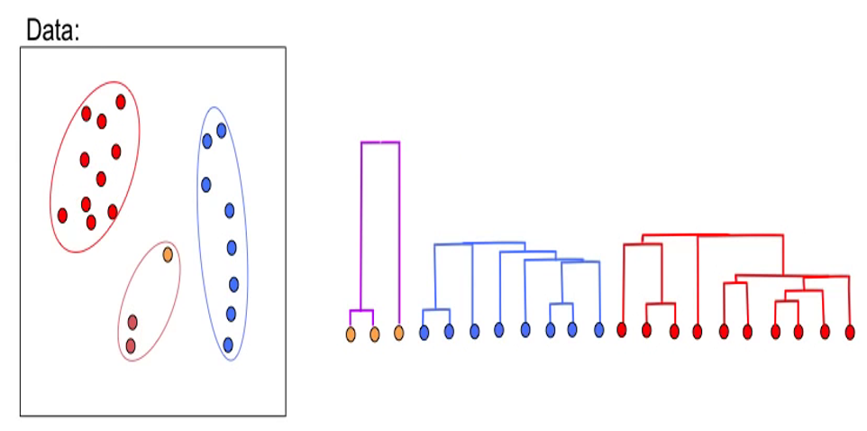
11.
Iteration M-3, build up a sequence of clusters (Hierarchical)
Dendrogram
RLADIES URMIA

Slide 24
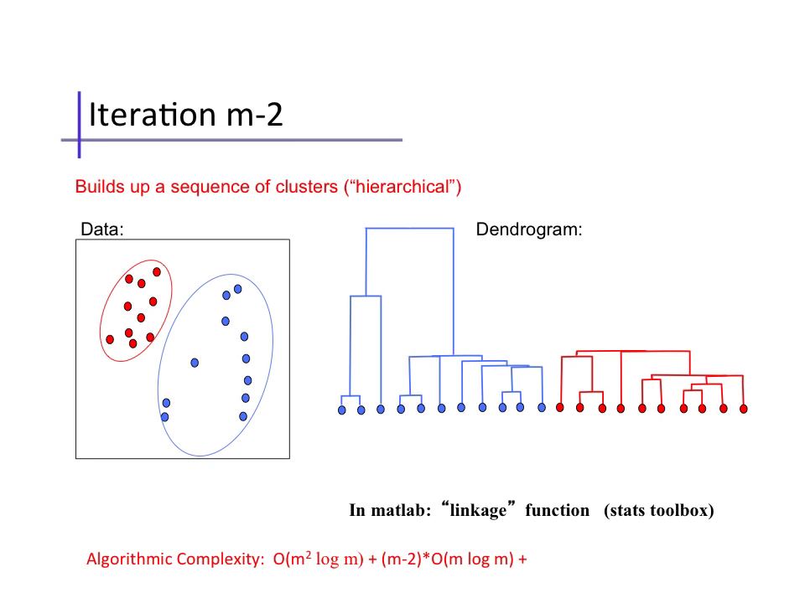
11.
Iteration M-2, build up a sequence of clusters (Hierarchical)
Dendrogram
RLADIES URMIA

Slide 25
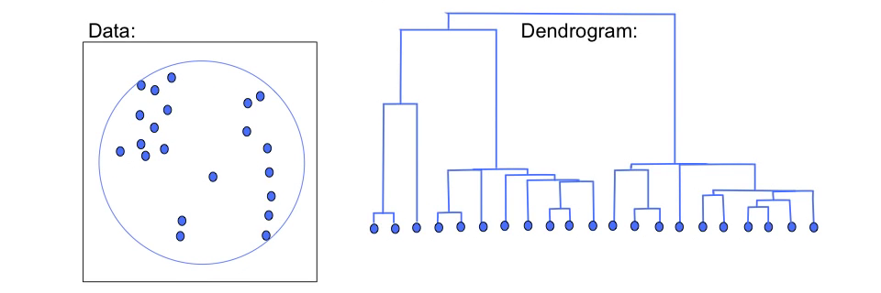
11.
Iteration M-1, build up a sequence of clusters (Hierarchical)
Dendrogram
RLADIES URMIA

Slide 26
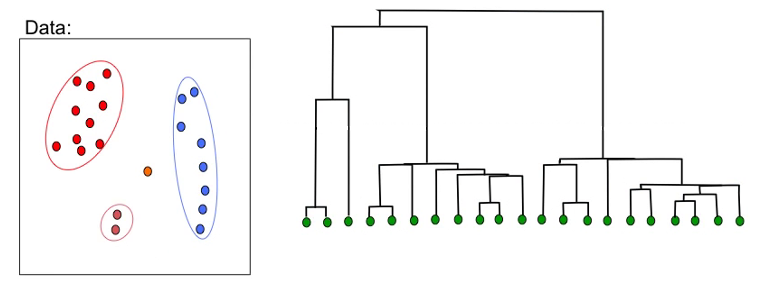
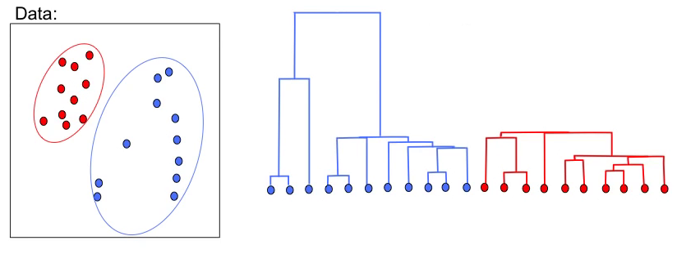
11.
From Dendrogram to Clusters Given the sequence, can select a number of clusters or dissimilarity threshold:
Dendrogram
RLADIES URMIA
1
2
3
4

Slide 27
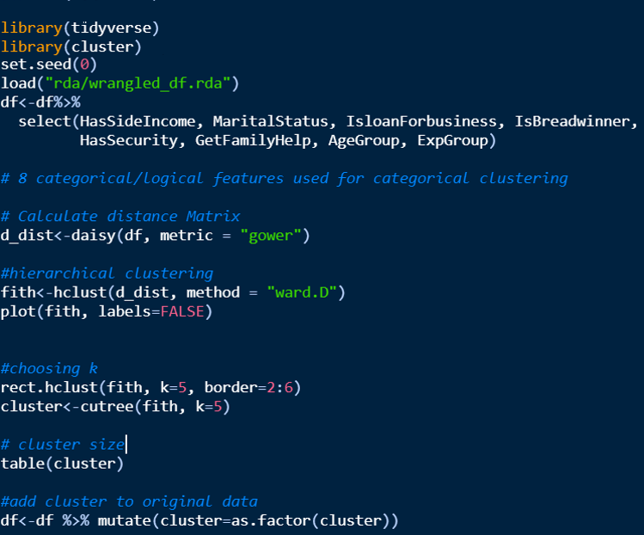
RLADIES URMIA

Slide 28
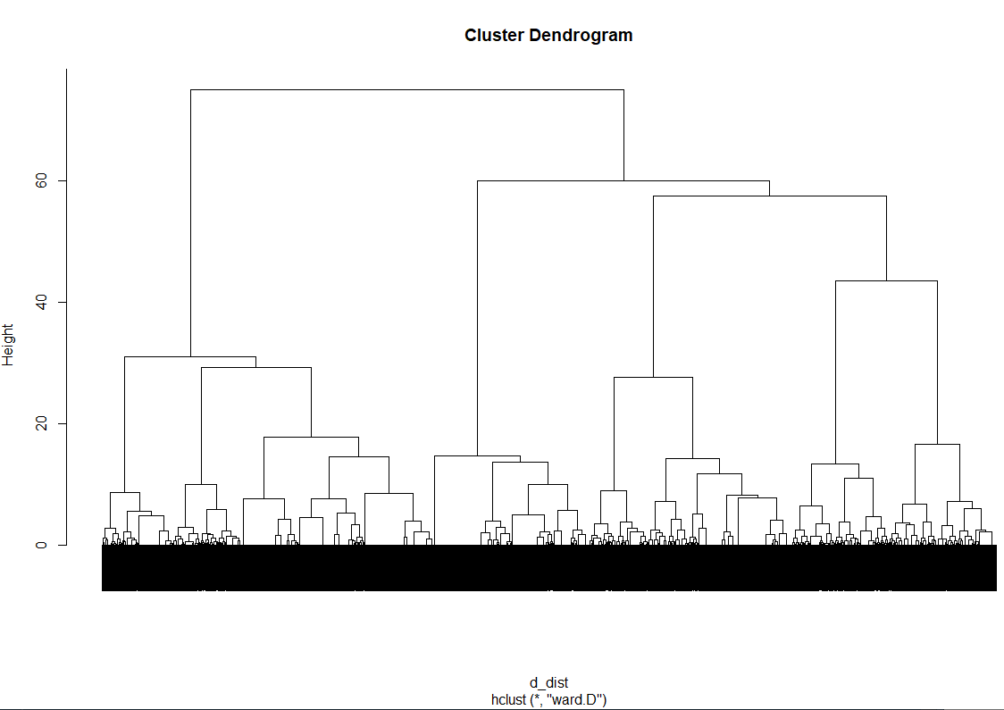
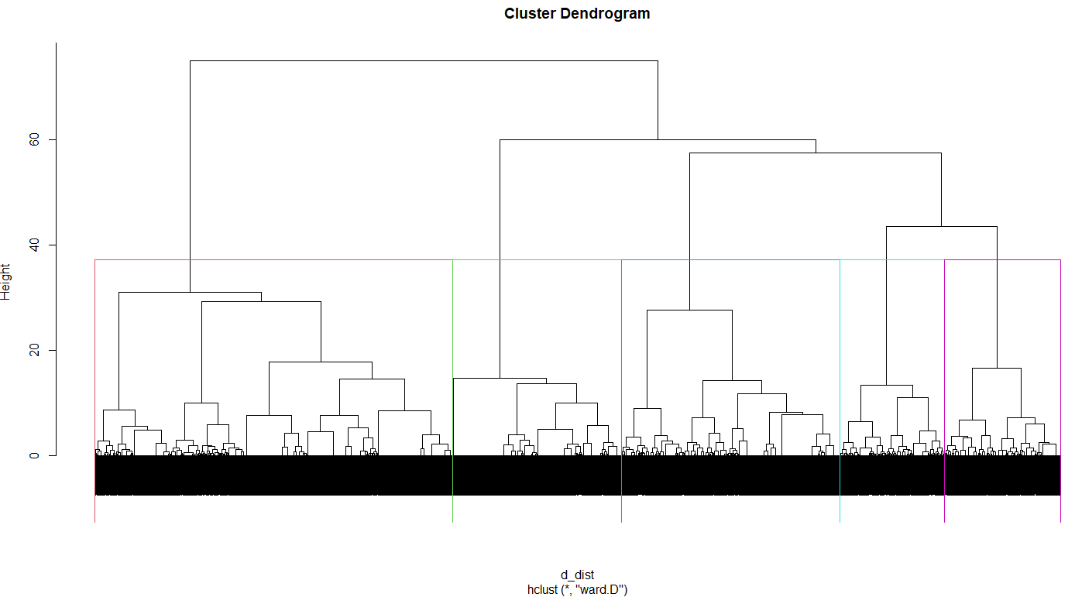
RLADIES URMIA
1
2
3
4
5

Slide 29
RLADIES URMIA
1
2
3
4
5

Slide 30
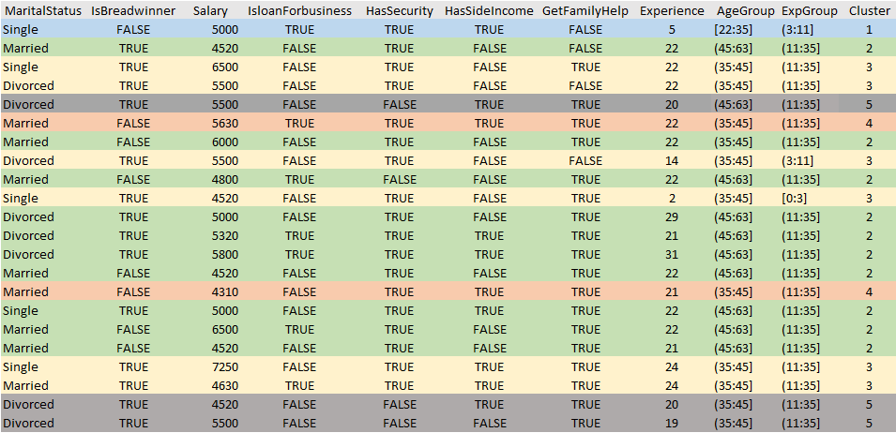
RLADIES URMIA

Slide 31
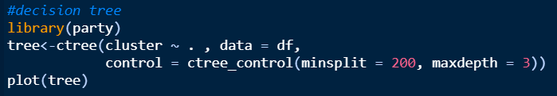
13.
Tree-Based Model
Conditional Inference Tree, party R Package
After clustering customers and adding cluster number as a new feature to data set, we can treat it as a classification problem and model it by a decision tree. Easy to interpret for non-technical client.
party Package
ctree()
RLADIES URMIA

Slide 32
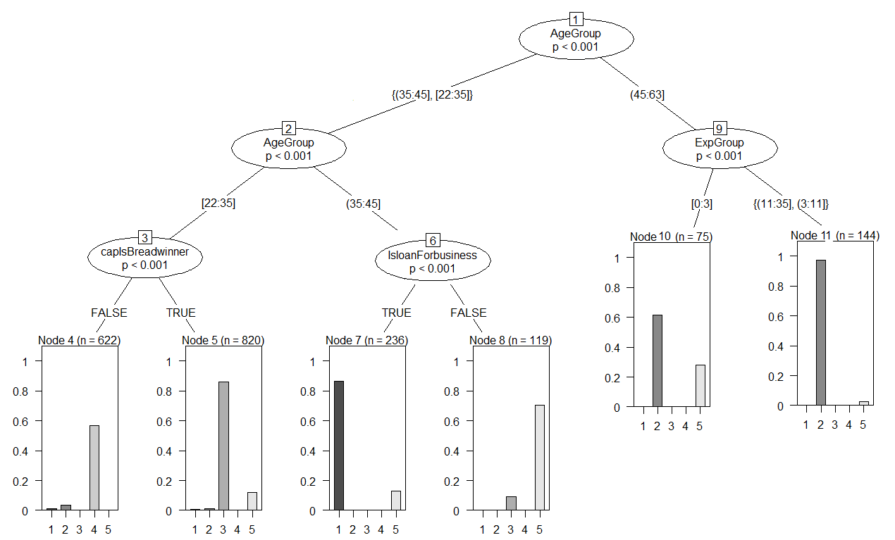
13.
Tree-Based Model
Conditional Inference Tree, party R Package
RLADIES URMIA
Dependent Elders
Independent Youth
Experienced Matures
Business Eagles
Young Angels
Active Marrieds
6 nodes

Slide 33
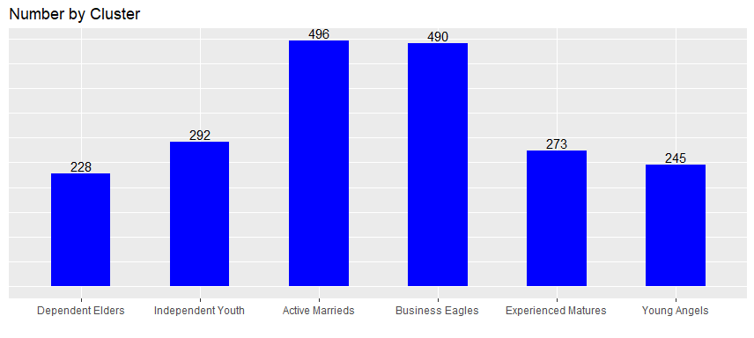
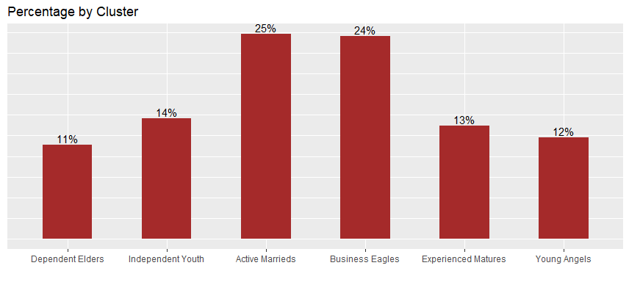
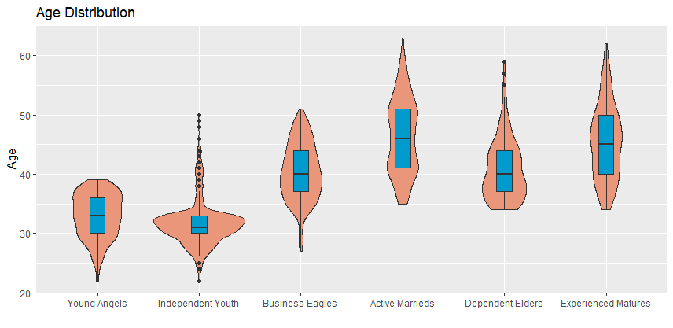
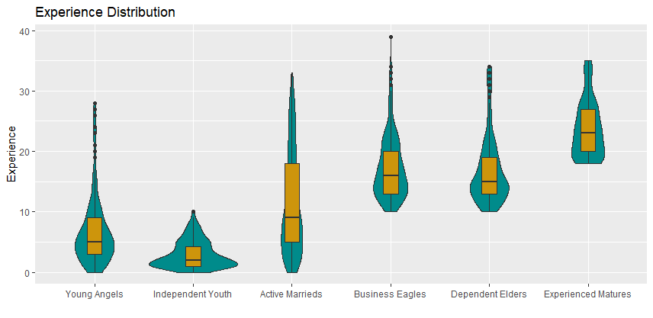
Data Visualization

Slide 34
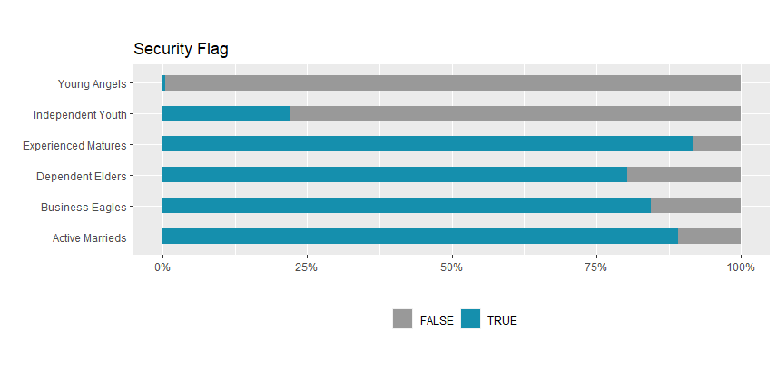
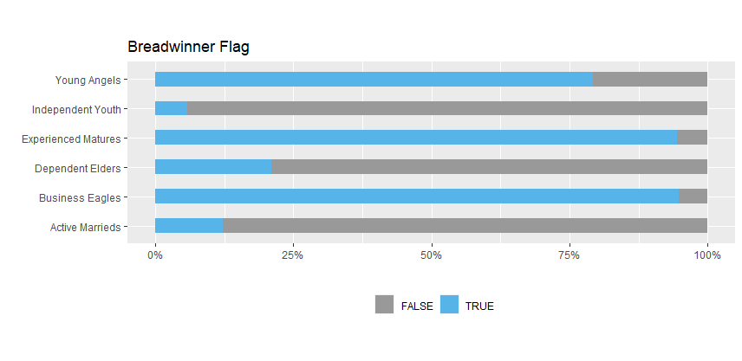
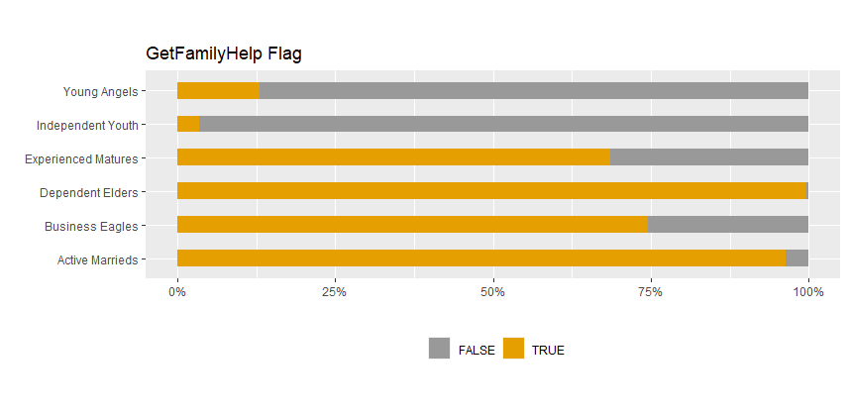
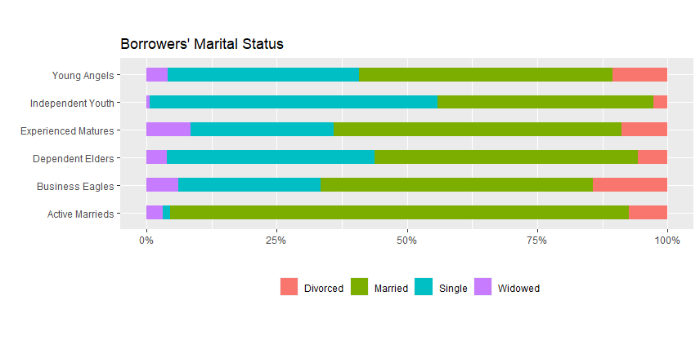
Data Visualization

Slide 35



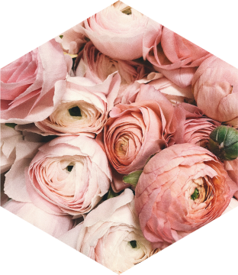
15.
Thank you Questions?
RLADIES URMIA
Contact me:
Email: marya.alizade@gmail.com Twitter: @Maryaalizadeh
Medium: @maryam.alizadeh
Kaggle: maryamalizadeh
LinkedIn: Marya Alizadeh

